Slide 1
CAPSTONE PROJECT
Telecom Churn Analysis
Pradeep Singh

Slide 2
CONTENT
Business Problem Understanding
Why Reducing Churn is Important
Data Summary
Exploratory Data Analysis
Challenges
Recommendation
Conclusion

Slide 3

Why Reducing Churn is Important
businesses making more than $10 million in revenue have an average churn rate of 8.5%, while those that make less than $10 million are likely to have a churn rate of 20% or higher;
two-thirds of SaaS businesses experience churn rates of 5% or more;
low-growth companies are more likely to experience high churn rates;
avoidable customer churn is costing businesses $136 billion a year.

Slide 4

OBJECTIVE
Maximize: Company's profit by retaining customer
Minimize: Customer churn by identifying the key cause of the problem
Business Constraint:
Provide offers and discount and improve the service quality without compromising with profit
Maintain company’s brand value

Slide 5


DATA SUMMARY
Numerical Data
Number vmail messages
Total day minutes
Total day calls
Total day charge
Total eve minutes
Total eve calls
Total eve charge
Total night minutes
Total night calls
Total night charge
Total intl minutes
Total intl calls
Total intl charge
Customer service calls
Account length
Decision Variable
Churn
Categorical Data
State
International plan
Voicemail plan
Nominal Data
Area code
TELECOM CHURN DATASET

Slide 6
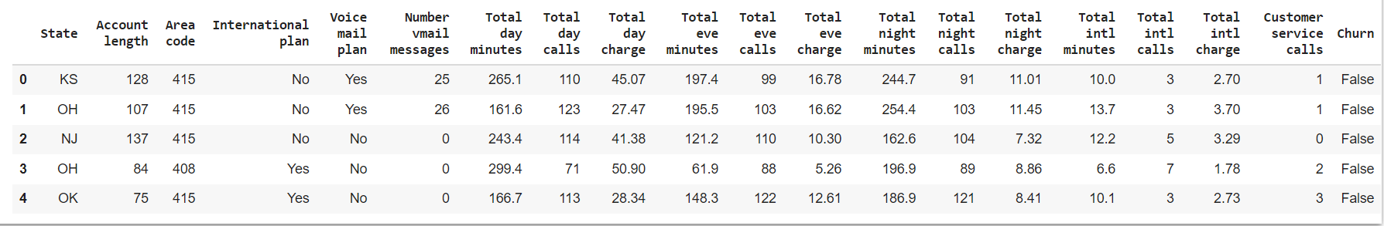
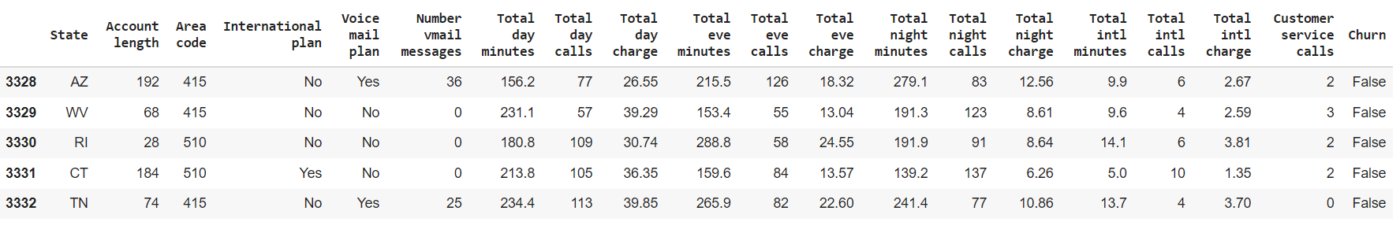
DATA SUMMARY
This is The Our Telecom Churn Dataset. In the below table it’s show the top and bottom 5 rows respectively

Slide 7
FEATURES DESCRIPTION
STATE: There are 51 unique state present
ACCOUNT LENGTH: It is the length that the customer used their account
AREA CODE: There are 3 unique area code present
TOTAL (DAY/EVENING/NIGHT/INTERNATIONAL) (MINUTES/CALLS/CHARGES):
These are total 12 columns, and all are numerical data types. These contain the data of calls, minutes, charges of the customer with respective to the various time of the day and plan.
INTERNATIONAL PLAN & VOICEMAIL PLAN:
Both column are described as a categorical feature, yes means plan taken no means plan not taken
NO. OF VOICEMAIL MESSAGES: The number of voicemail make by the voicemail plan taken customer
Customer service calls:It is the number of calls made by the customer to operator service centre
Churn:it is our target dependent variable having boolean data type of true and false

Slide 8
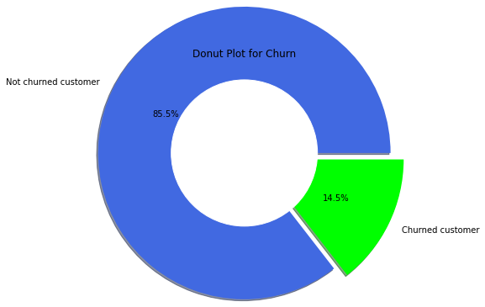
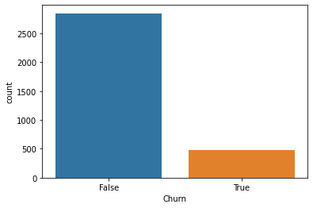
ANALYZING DEPENDENT VARIABLE “CHURN”
Below plot on the left side is a donut plot shows the percentage of total churned and not churned customer
And on the right side count plot shows the number of customer churned and not churned

Slide 9
ANALYZING DEPENDENT VARIABLE “CHURN”
Total Users number - 3333.
2850 - Non churn (85.5%)
483 - Churn (14.5%)
From the above donut plot and count plot, It was found from this analysis that almost 14.5% of customers had churned .

Slide 10
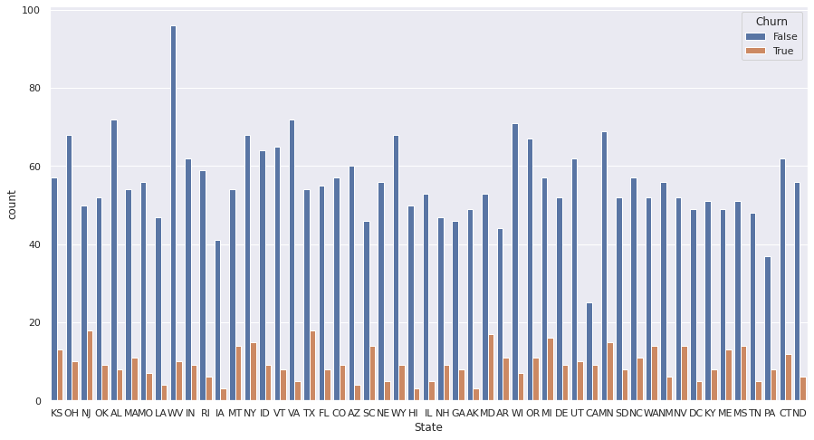
ANALYSIS STATE COLUMN
This Plot shows the Churn in each state

Slide 11
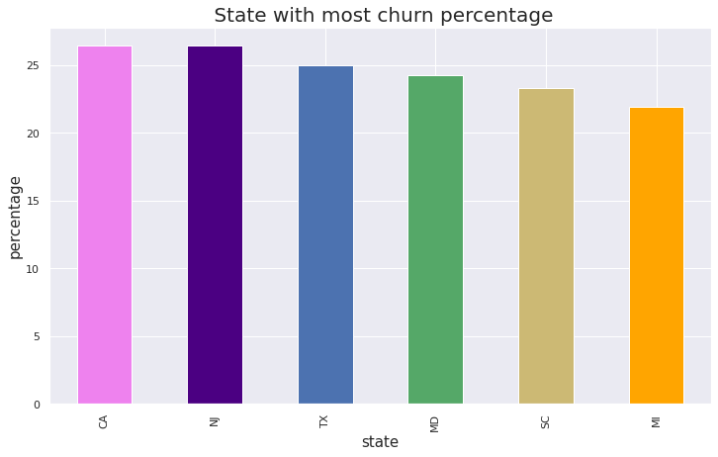
TOP STATE CHURN PERCENTAGE
CA, NJ ,TX , MD ,SC ,MI are the ones who have higher churn rate more than 21.74%

Slide 12
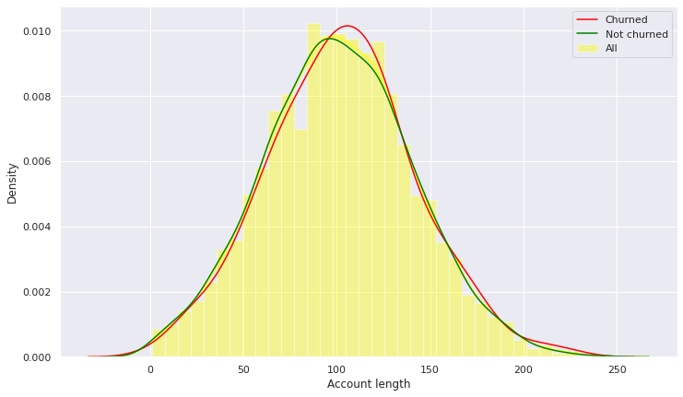
ACCOUNT LENGTH vs. CHURN
This Plot show effect of Account Length on Churn
Here is no sign of customers leaving because of the length of usage of their account.

Slide 13
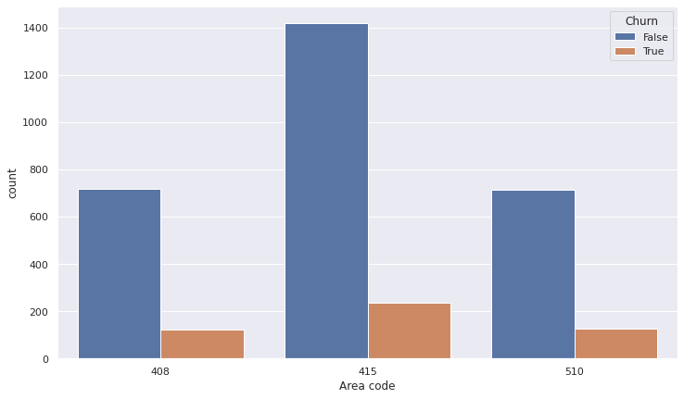
ANALYSIS OF AREA CODE
This plot graph shows all the values with churn
Area code has only 3 unique values, and consider as a nominal data type and has equal number of churn

Slide 14
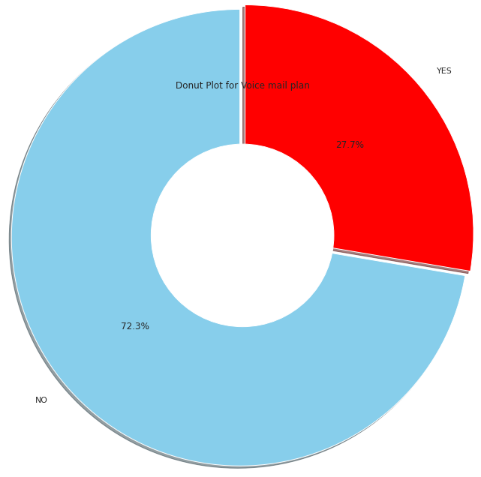
ANALYSIS OF VOICEMAIL PLAN
There are 3333 people,
922 having Voicemail plan,
2411 do not have any Voicemail plan.

Slide 15
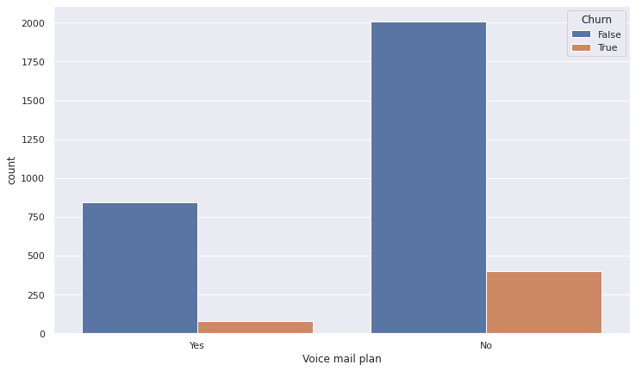
VOICEMAIL PLAN vs. CHURN
This plot shows churn corresponding with the subscription of voicemail plan
Out of 922 people having Voicemail plan, 8.7% are Churn.

Slide 16
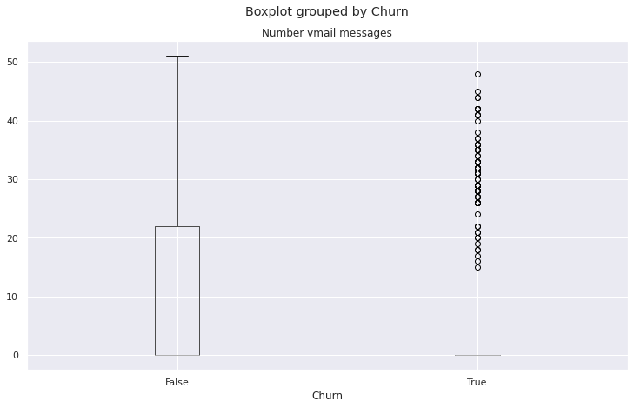
NO. OF VOICEMAIL vs.CHURN
This box plot shows the relation between churn and no. of vmail
when there are more than 20 voice-mail messages then there is a churn

Slide 17
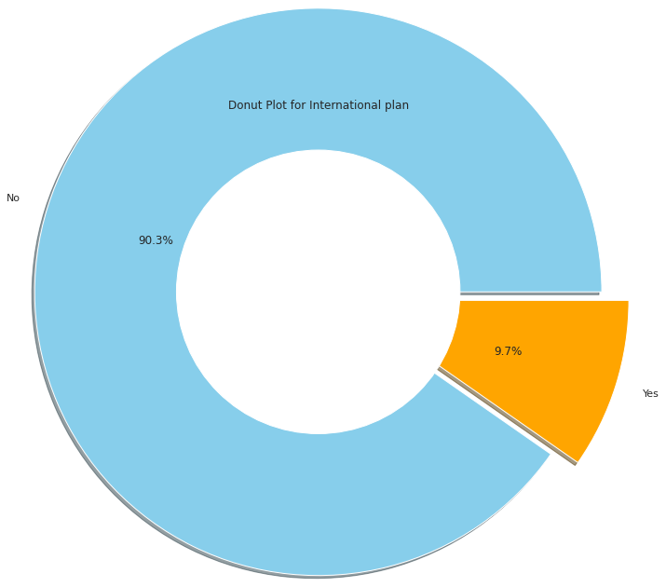

INTERNATIONAL PLAN
There are 3333 people
323 have a International Plan
3010 do not have International Plan

Slide 18
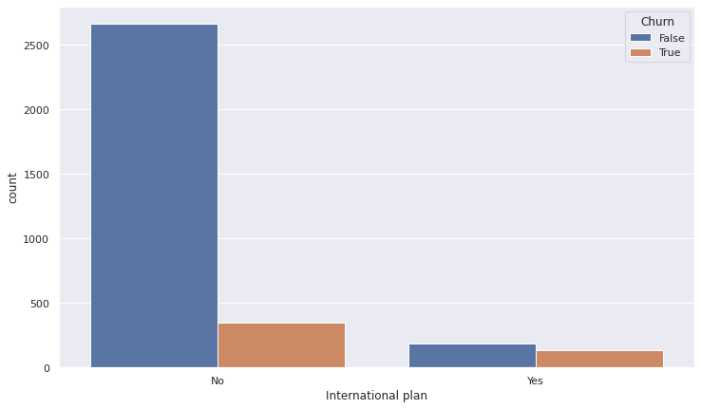
INTERNATIONAL PLAN vs. CHURN
This is a count plot which shows the churned and not churned customer respective to their international plan

Slide 19

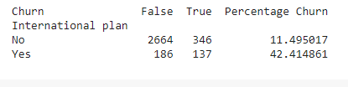
INTERNATIONAL PLAN vs. CHURN
This side table map shows data about the percentage churn according to the international plan
Which clearly shows that the churn percentage is 42.41% who takes the international plan
That means there is some cause which effects the churn rate like call price or network issue

Slide 20
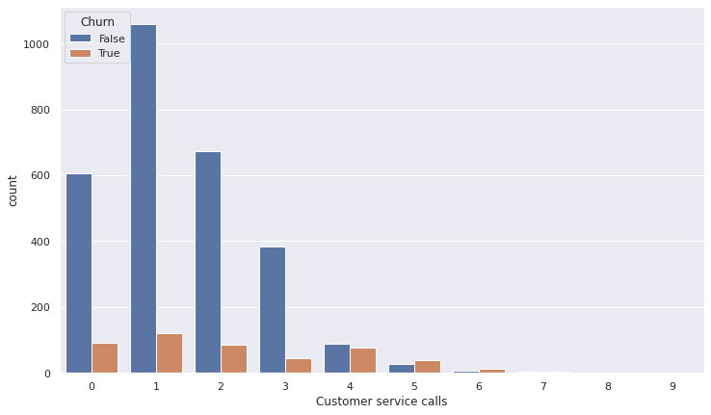
CUSTOMER SERVICE CALLS vs. CHURN
This plot shows Churn for number of customer service calls

Slide 21
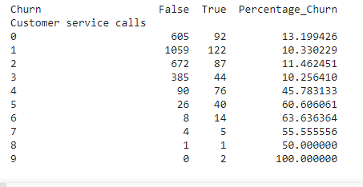
CUSTOMER SERVICE CALLS vs. CHURN
This table mapping number of customer calls to the churn percentage
It’s clear that after 4 calls at least 45% of the subscribers churn.
Customers with more than 4 service calls their probability of leaving is more

Slide 22
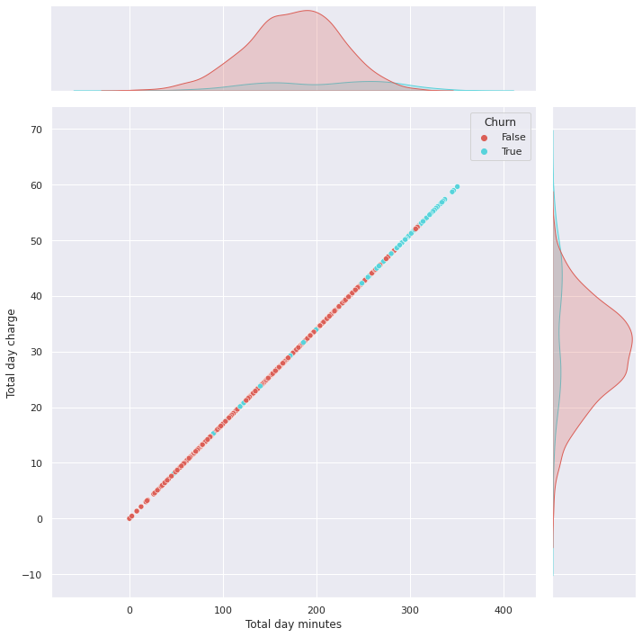
DAY CALL MINUTES & DAY CALL CHARGE vs. CHURN
Joint-plot shows the relation between total day minutes with churn
Joint-plot shows the relation between total day call charges with churn
Below joint-plot shows that with users spending more 225 minutes or more tend to switch to other operator.
The customer who have high call minutes also have high call price these tends to churn

Slide 23
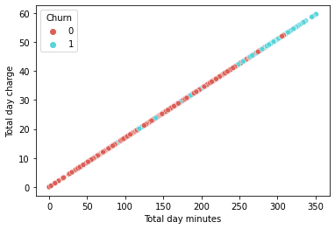
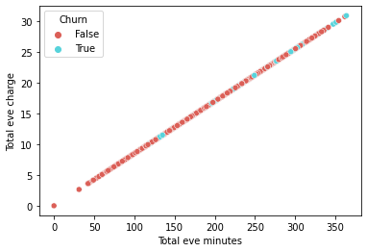
ANALYZING ALL CALLS MINUTES,ALL CALLS, ALL CALLS CHARGE
Below plots are scatter plot which shows the relation between calls and churn
Left side plot shows the Total day minutes, Total day charge
With churn
Right side plot shows the Total eve minutes, Total eve charge
With churn

Slide 24
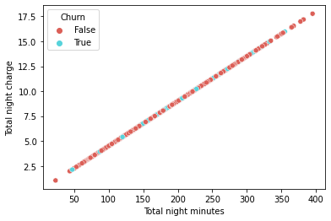
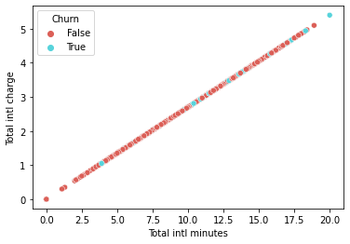
ANALYZING ALL CALLS MINUTES,ALL CALLS, ALL CALLS CHARGE
Left side scatter plot shows the Total night minutes, Total night charge
With churn
Right side plot shows the Total international minutes, Total international charge With churn

Slide 25
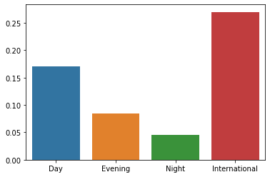
COMPARISON OF CALL CHARGES PER MINUTE
Below this bar plot shows the comparison between all call charges per minute
International call charges are high as compare to others it's an obvious thing but that may be a cause for international plan customers to churn out.

Slide 26
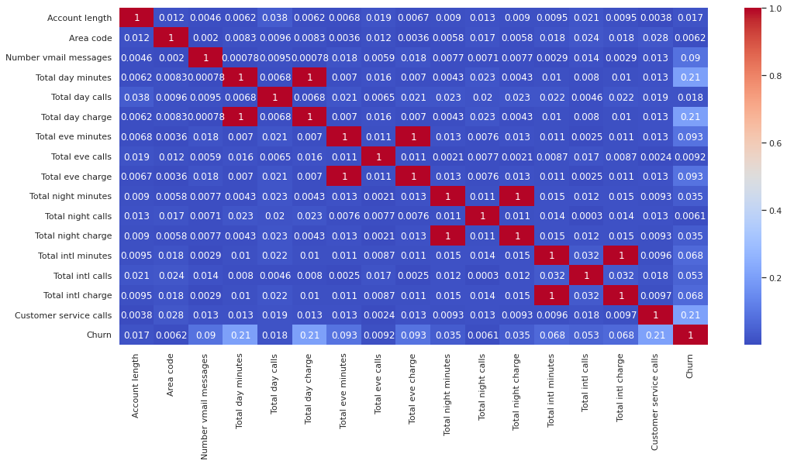
CORRELATION MATRIX

Slide 27
CHALLENGES
Difficult to analyze columns like categorical feature Data types.
Need to plot lot of graph for columns as to understand the data.
For calls data there is no direct relation to churn but related column has played important role.

Slide 28
CONCLUSION
There are some states where the churn rate is high as compared to others may be due to low network coverage.
Area code and account length do not play any kind of role regarding the churn rate.
In the international plan those customers who have this plan are churn more and also the international calling charges are also high so the customer who has the plan unsatisfied with network issues and high call charge.
In the voicemail section when there are more than 20 voice-mail messages then there is a churn so it basically means that the quality of voice mail is not good.
The customer who have high day call minutes also have high call price these customer tends to churn.
In customer service calls data shows us that whenever an unsatisfied customer called the service centre the churn rate is high, which means the service centre didn't resolve the customer issue.

Slide 29
RECOMMENDATIONS
Improve network coverage churned state
In international plan provide some discount plan to the customer retention
Improve the voicemail quality or take feedback from the customer
Provide discount to those customer who spent more minutes of time on call
Improve the service of call centre and take frequently feedback from the customer regarding their issue and try to solve it as soon as possible

Slide 30
THANK YOU

